Slide 1
AWS Security Intro

Slide 2
Security Models
CIA, AAA, Non repudiation
Confidentiality – IAM, MFA
Availability – ASG, multi AZ
Integrity – Certificate manager, Bucket policies
Authentication - IAM
Authorization - Policies
Accountability – Cloudtrail

Slide 3
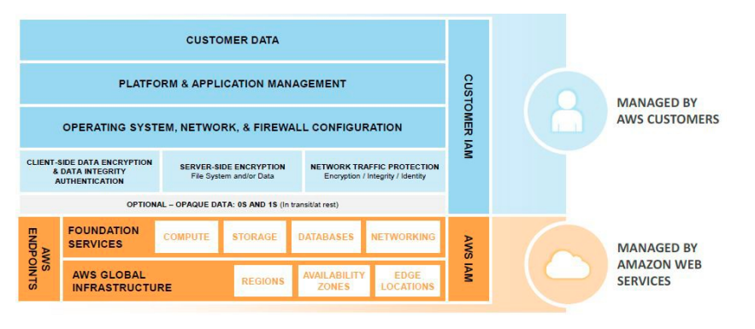
Shared responsibility model - infra

Slide 4
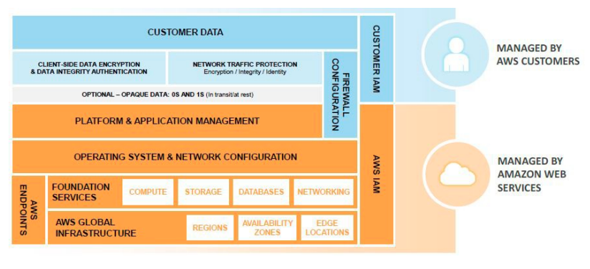
Shared responsibility model - containers

Slide 5
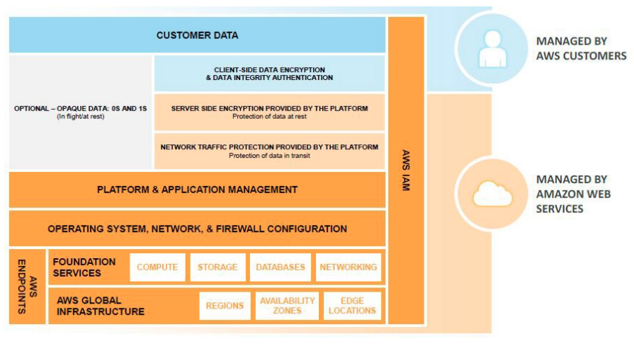
Shared Responsibility model – abstracted

Slide 6
Security points
Visibility – AWS Config – get resources and track configurations and make rules to check on things like expired certs
Controllability – KMS or CloudHSM (FIPS 142 compliance)
Agility – CFN, beanstalk – adapting to changes
Automation – OpsWorks, codedeploy

